Slide 1
Hotel Booking cancellation prediction
By Chris Alexander
University of Colorado, Boulder

Slide 2
Content
Introduction
Dataset
Exploratory data analysis
Prediction models
Learning
Conclusion

Slide 3
INTRODUCTION
​Cancellation is a benefit to the customers but not to the hotel.
Booking cancellation causes diminishing revenue for the hotel industry.

Slide 4
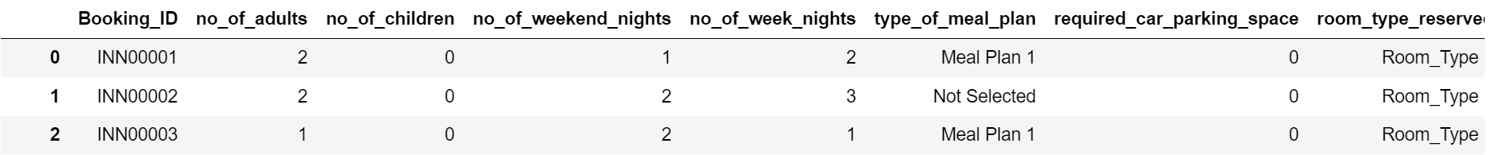
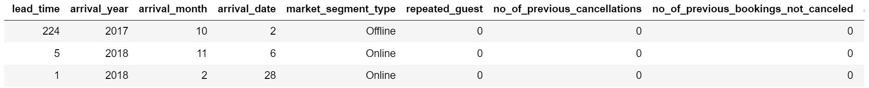
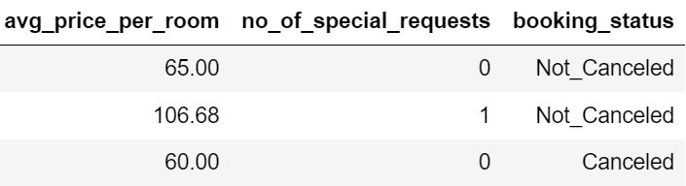
Overview of the Dataset
Data set is from Kaggle.
Notes:
No mention of which hotel and location.

Slide 5
Data Preprocessing
Removed duplicate entries.
One hot /label encode categorical data.
Handled NaN values

Slide 6
Exploratory Data analysis

Slide 7
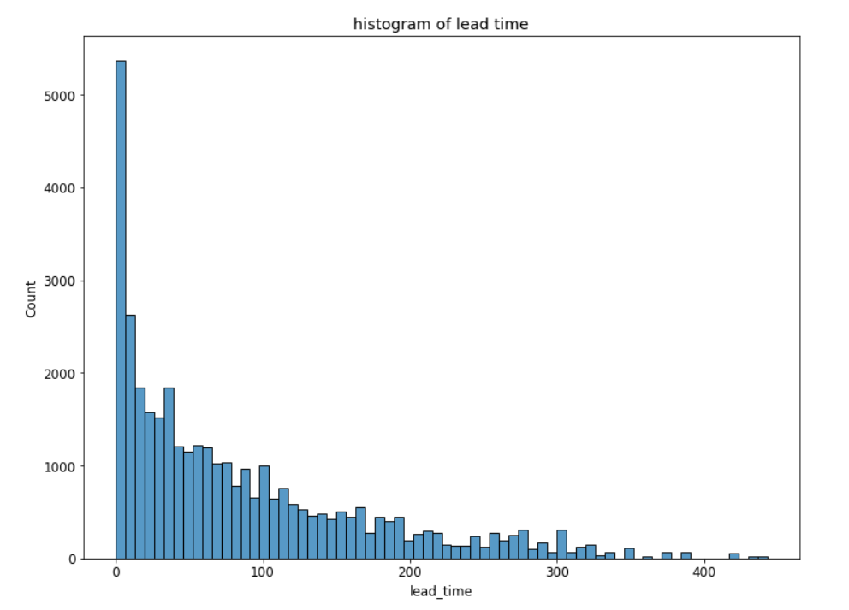
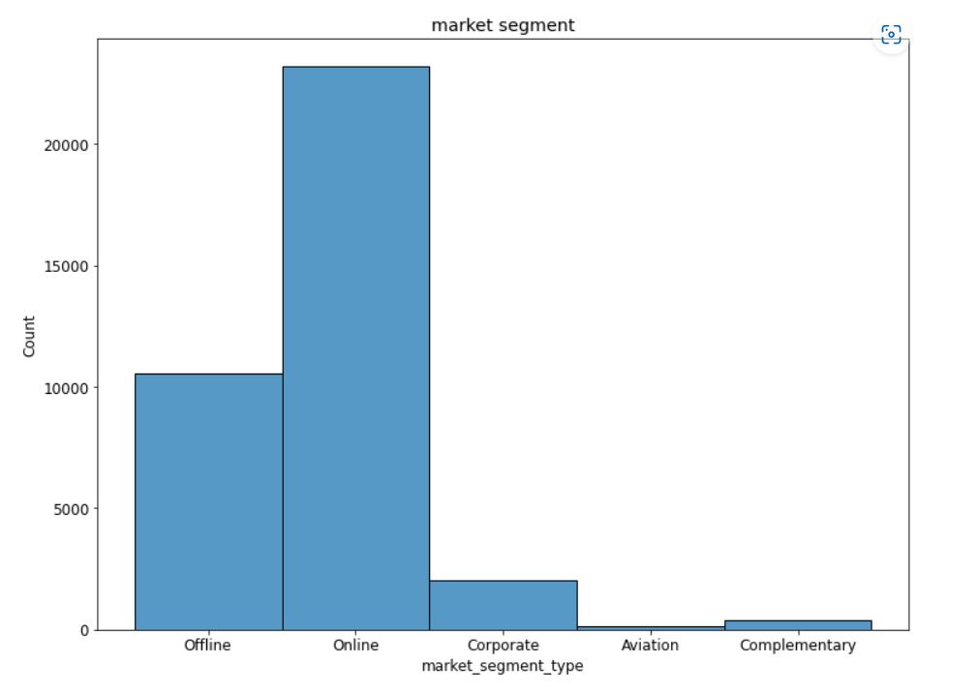
EDA
Most Booking is done with in 30 days of stay.
Majority of booking are online booking

Slide 8
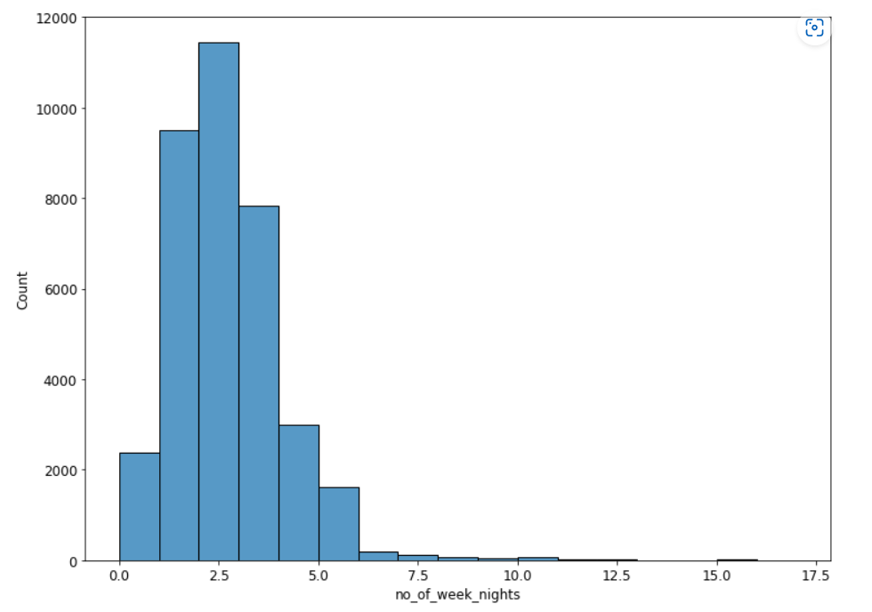
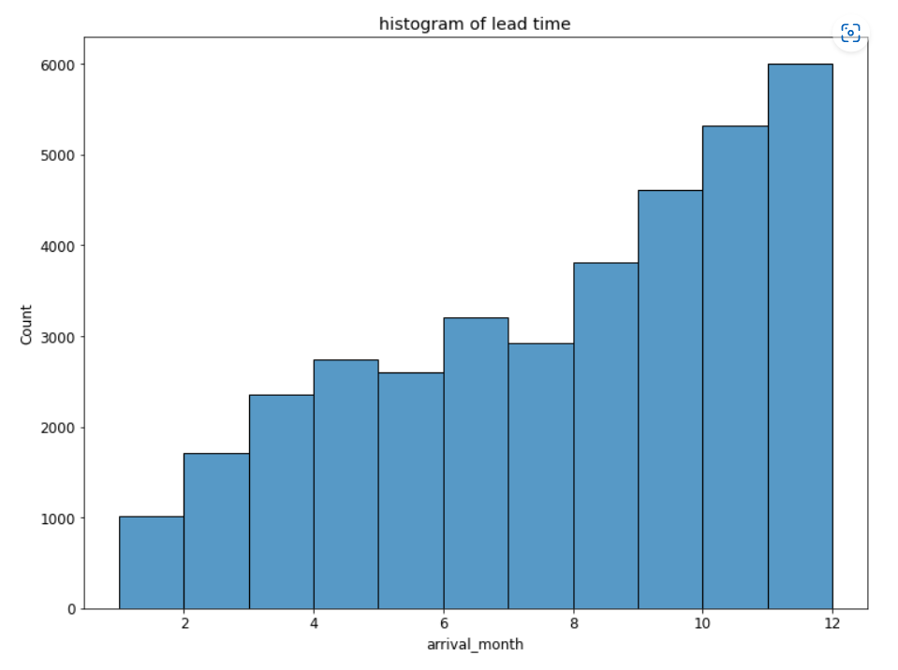
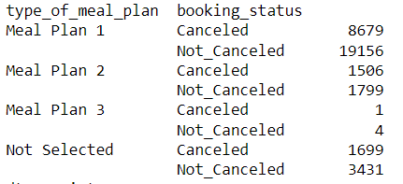

Slide 9
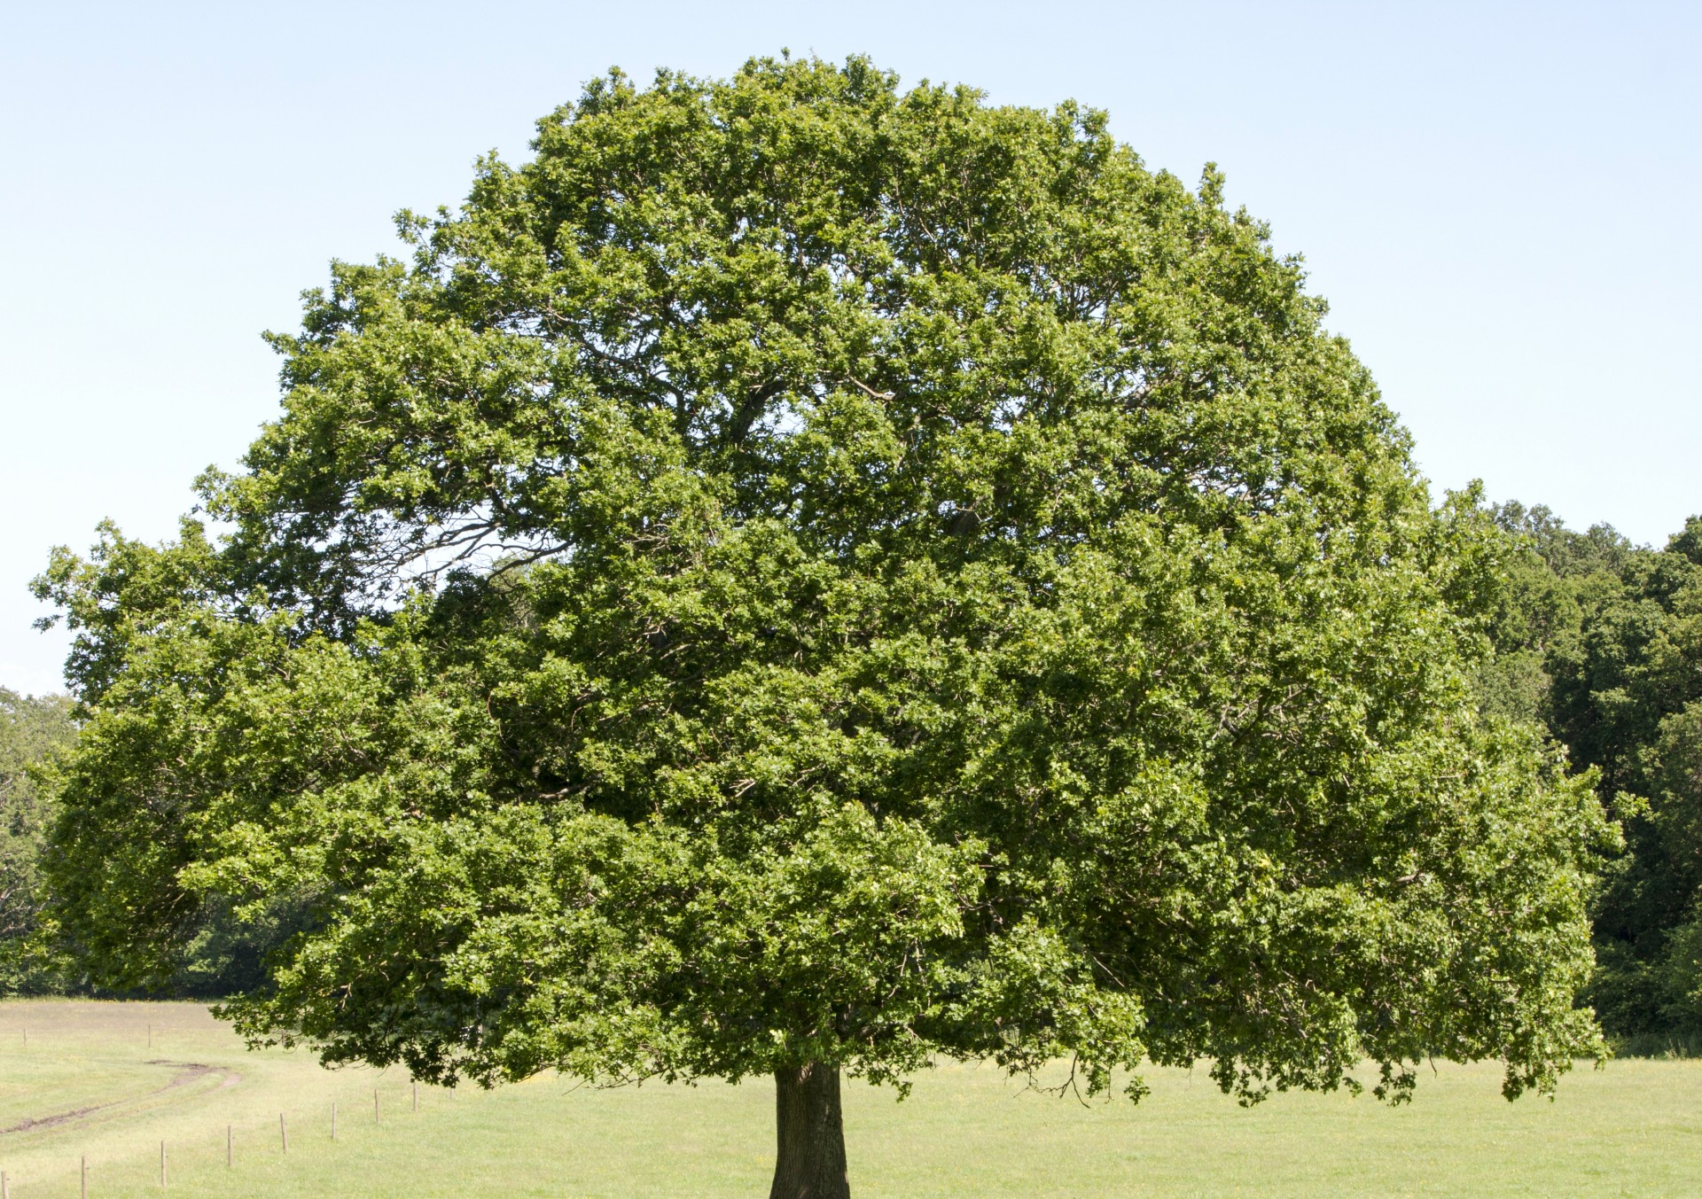
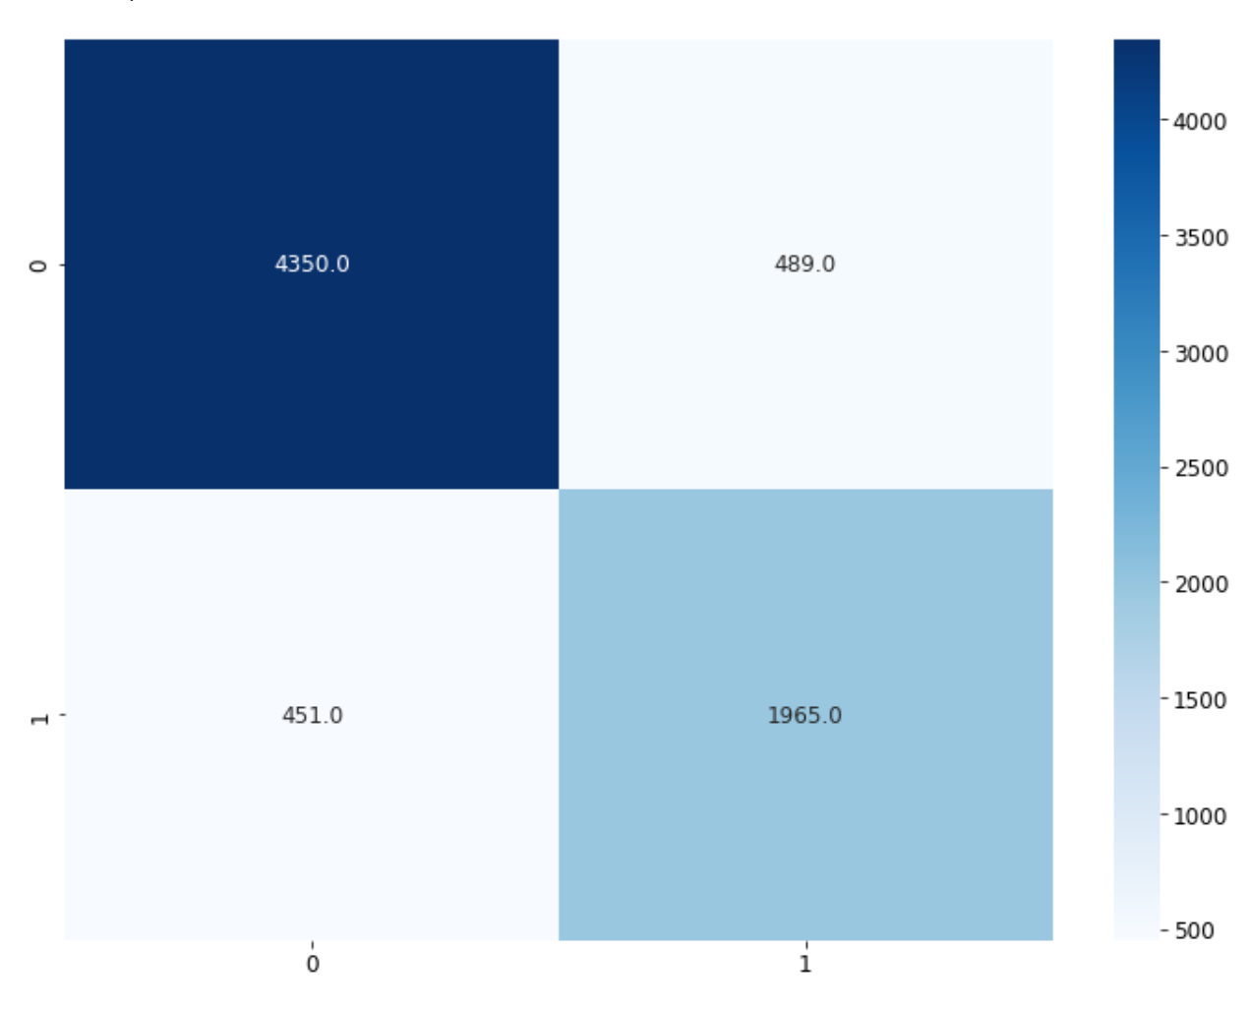

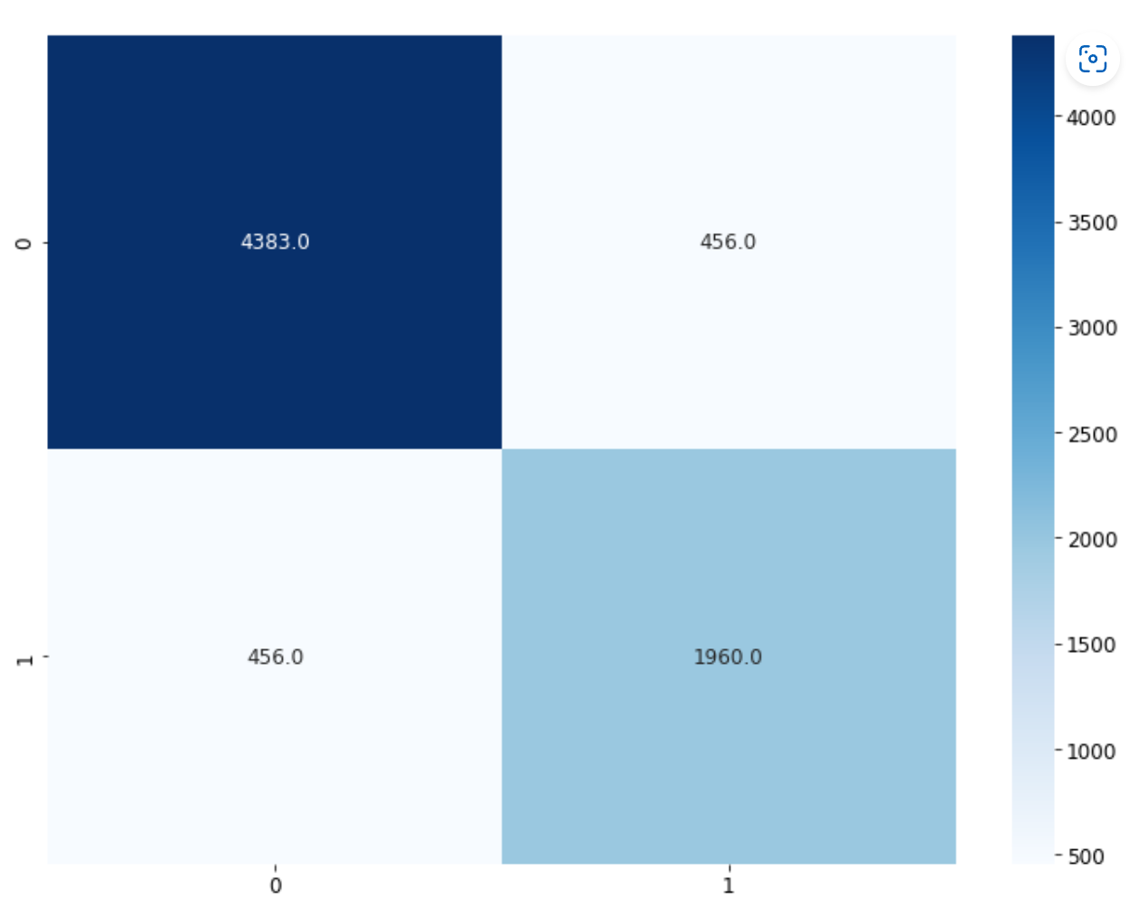

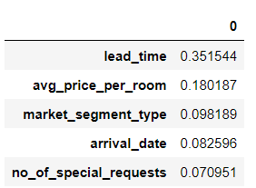
Prediction using decision tree
Important features
Notes:
Talk about performance without setting dept
With depth of 20
Important features
Sensitive to training data

Slide 10
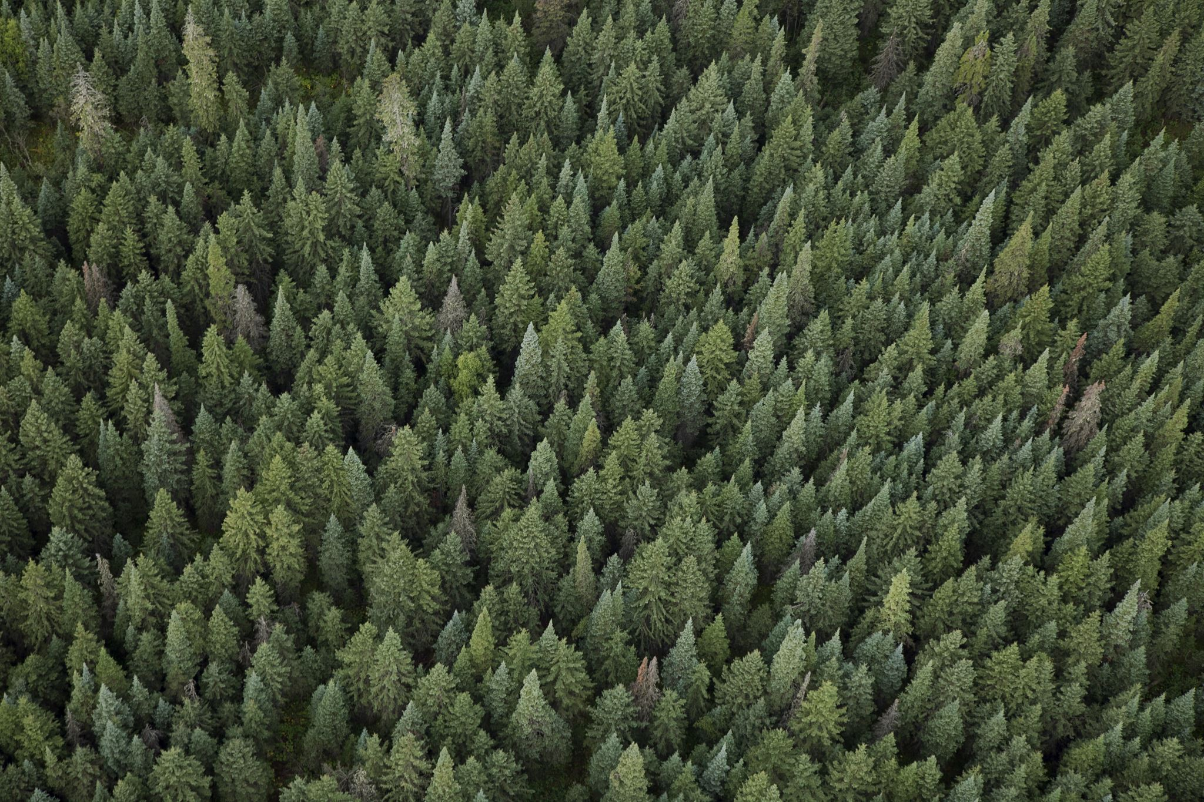
Random Forest Classifier
Ensemble based Algorithm Inherently does bagging
Not sensitive to training data

Slide 11
Learning

Slide 12
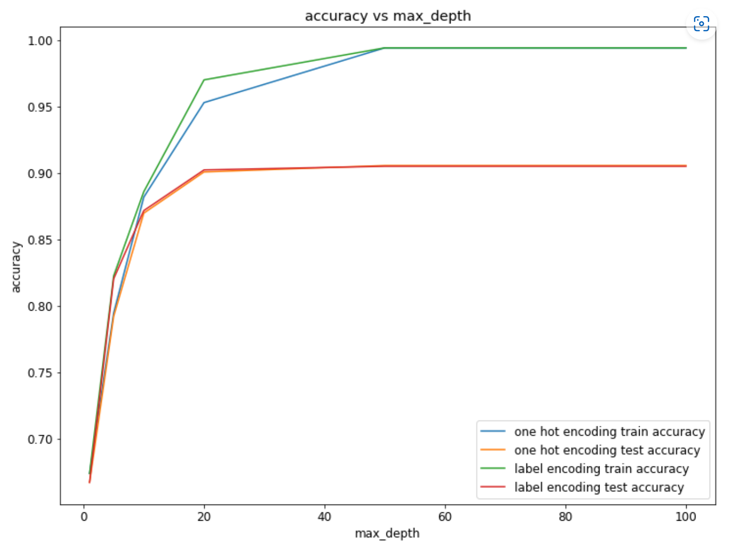


Effect of One hot encoding on Random forest
One Hot Encoding
Label Encoding

Slide 13


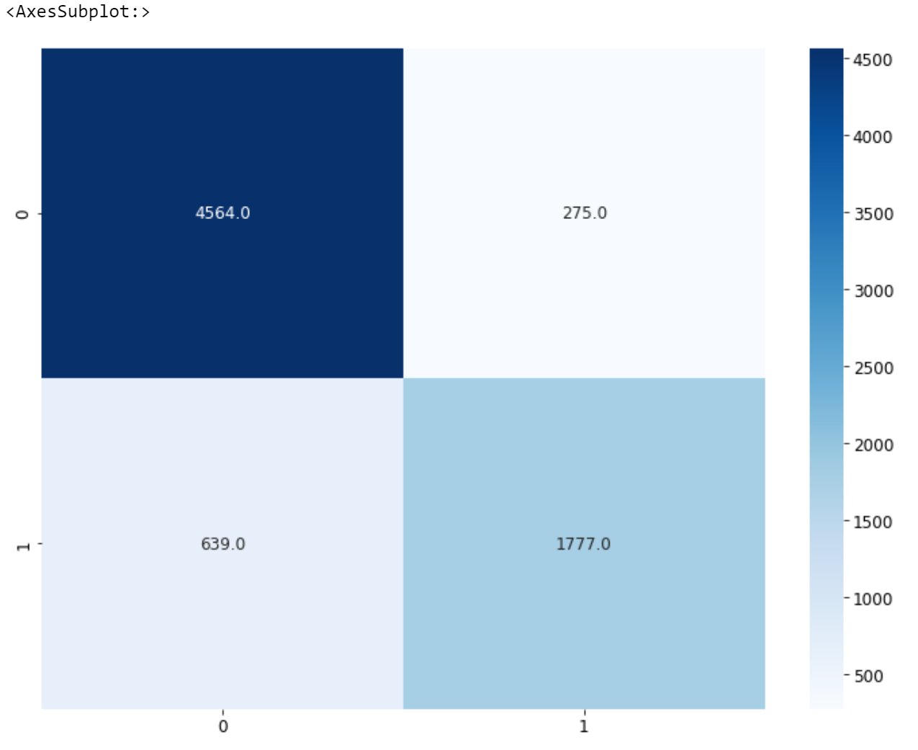
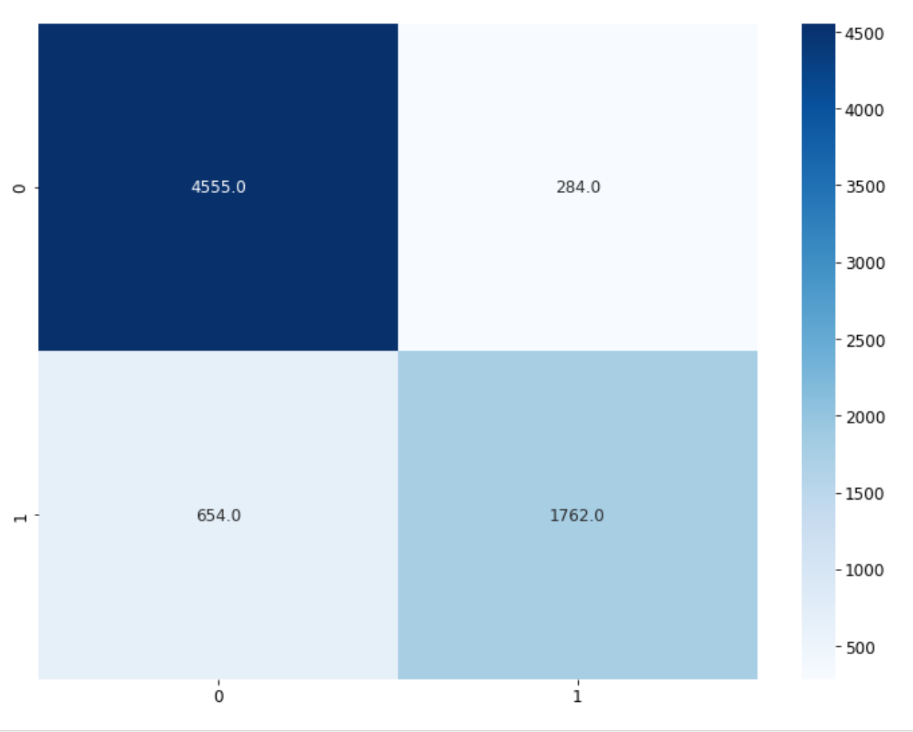
Feature Scaling
Without Standard scalar
With standard scalar

Slide 14
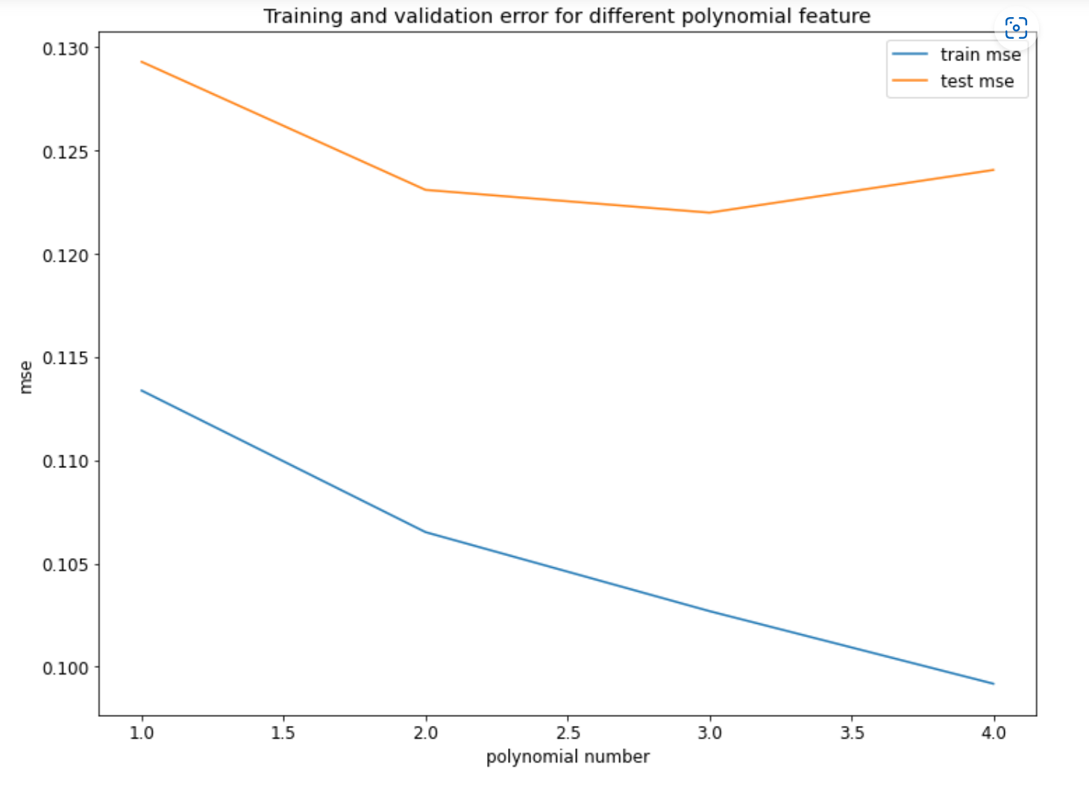
Polynomial feature
Doesn’t contribute a lot to reduce error.
New features generated may have some importance.

Slide 15
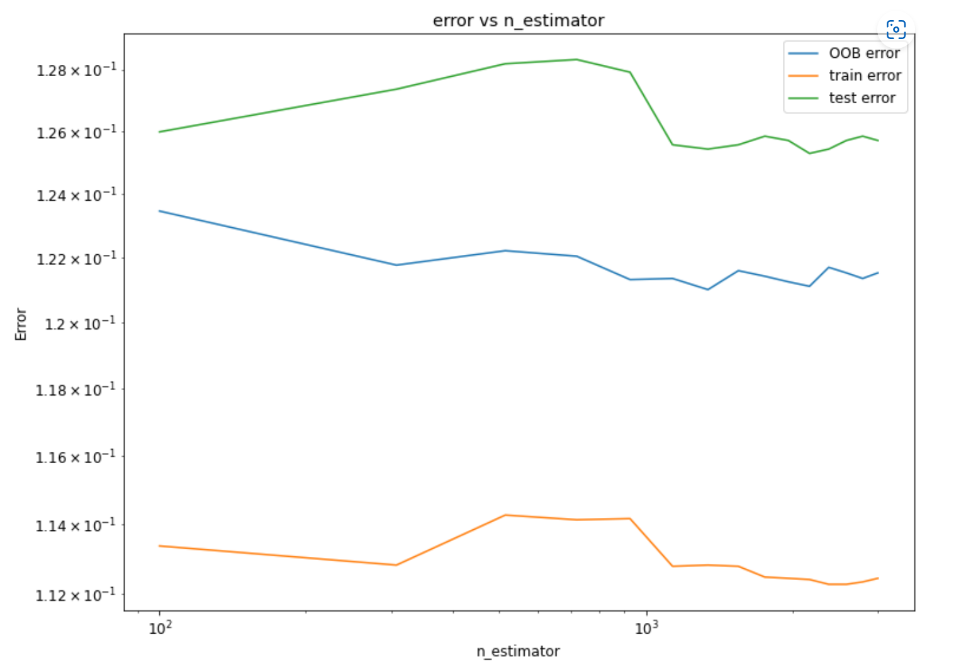
ideal number of trees
Increasing the number of trees does not reduce error significantly.
Higher number trees improves our confidence in the prediction.

Slide 16
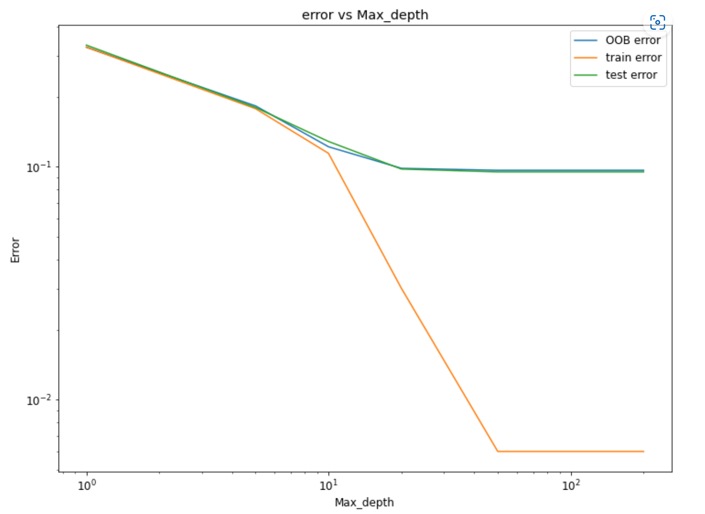
Effect of depth of trees
Ideal depth is in the range 10-20

Slide 17


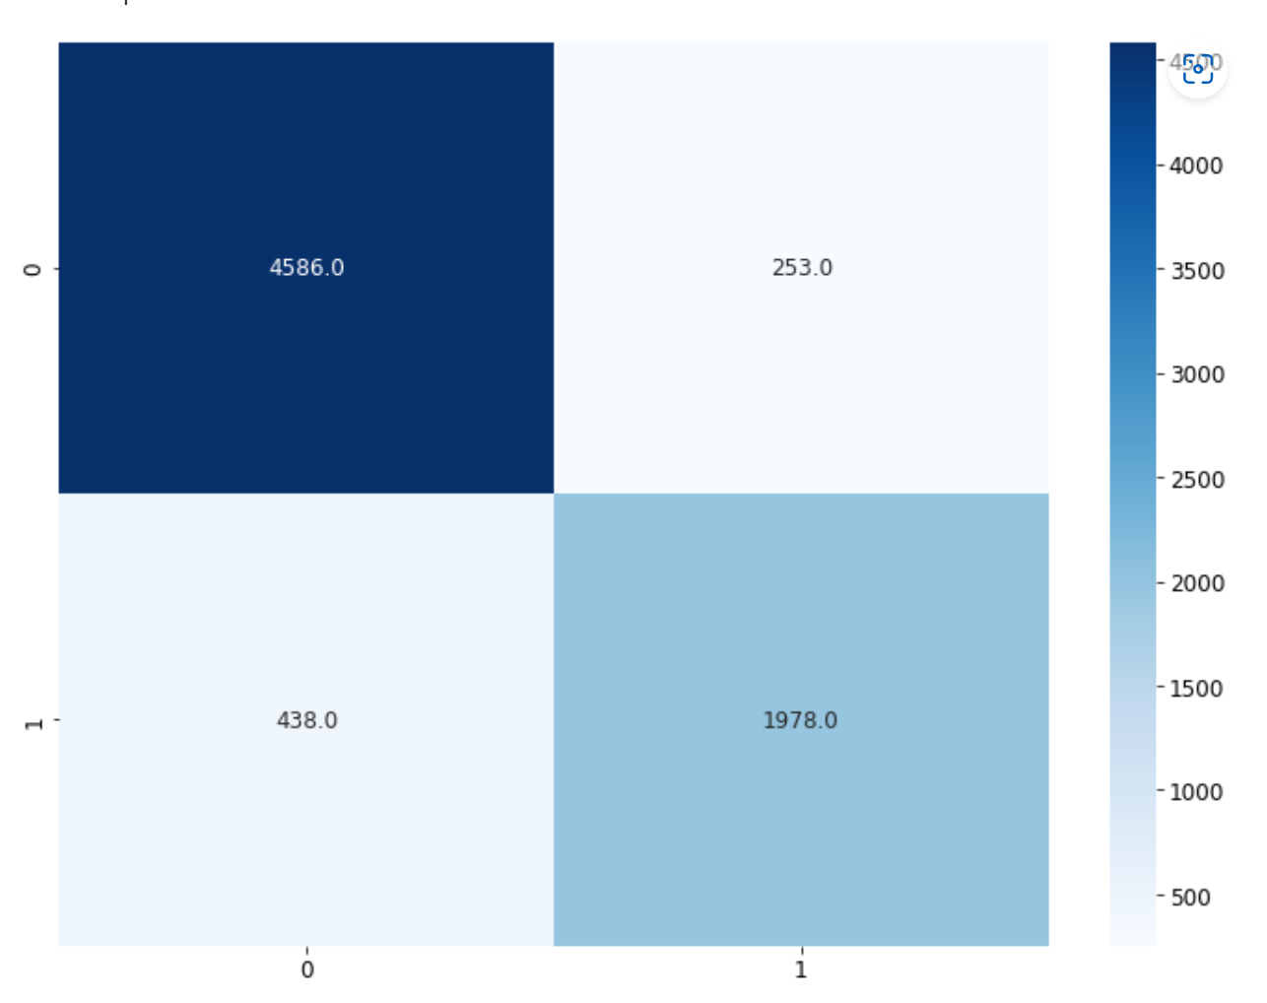

Parameter Tuning
RandomizedsearchCV generated parameters
Parameters based on previous analysis
N_estimators=1964
Max_depth=150
Min_sample_split=2
Min_sample_leaf=1
N_estimators=1200
Max_depth=17
Min_sample_split=2
Min_sample_leaf=1
Notes:
Can say the model is generalized
My parameters takes into consideration computation time

Slide 18
Conclusion
Random forest is a robust ensemble-based model.
Is less prone to feature scaling.
One hot encoding negatively effects performance of tree-based models based on application.
Higher number of trees in a forest may be redundant in some use cases.
Deeper trees will cause overfitting.

Slide 19
Next step
Try to implement tree-based algorithm from scratch.
Look into other tree-based models.

Slide 20
THANK YOU

